Slide 1
final project
Iskender Kuttubaev
11/29/2023

Slide 2
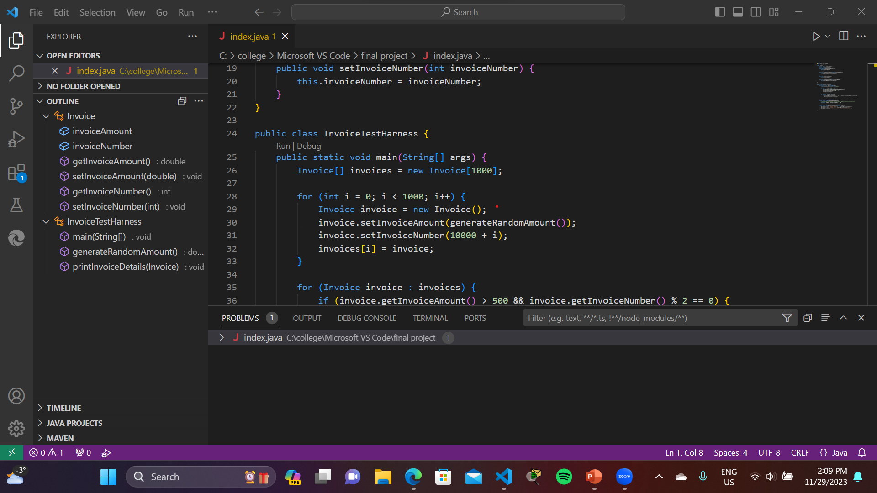

Slide 3
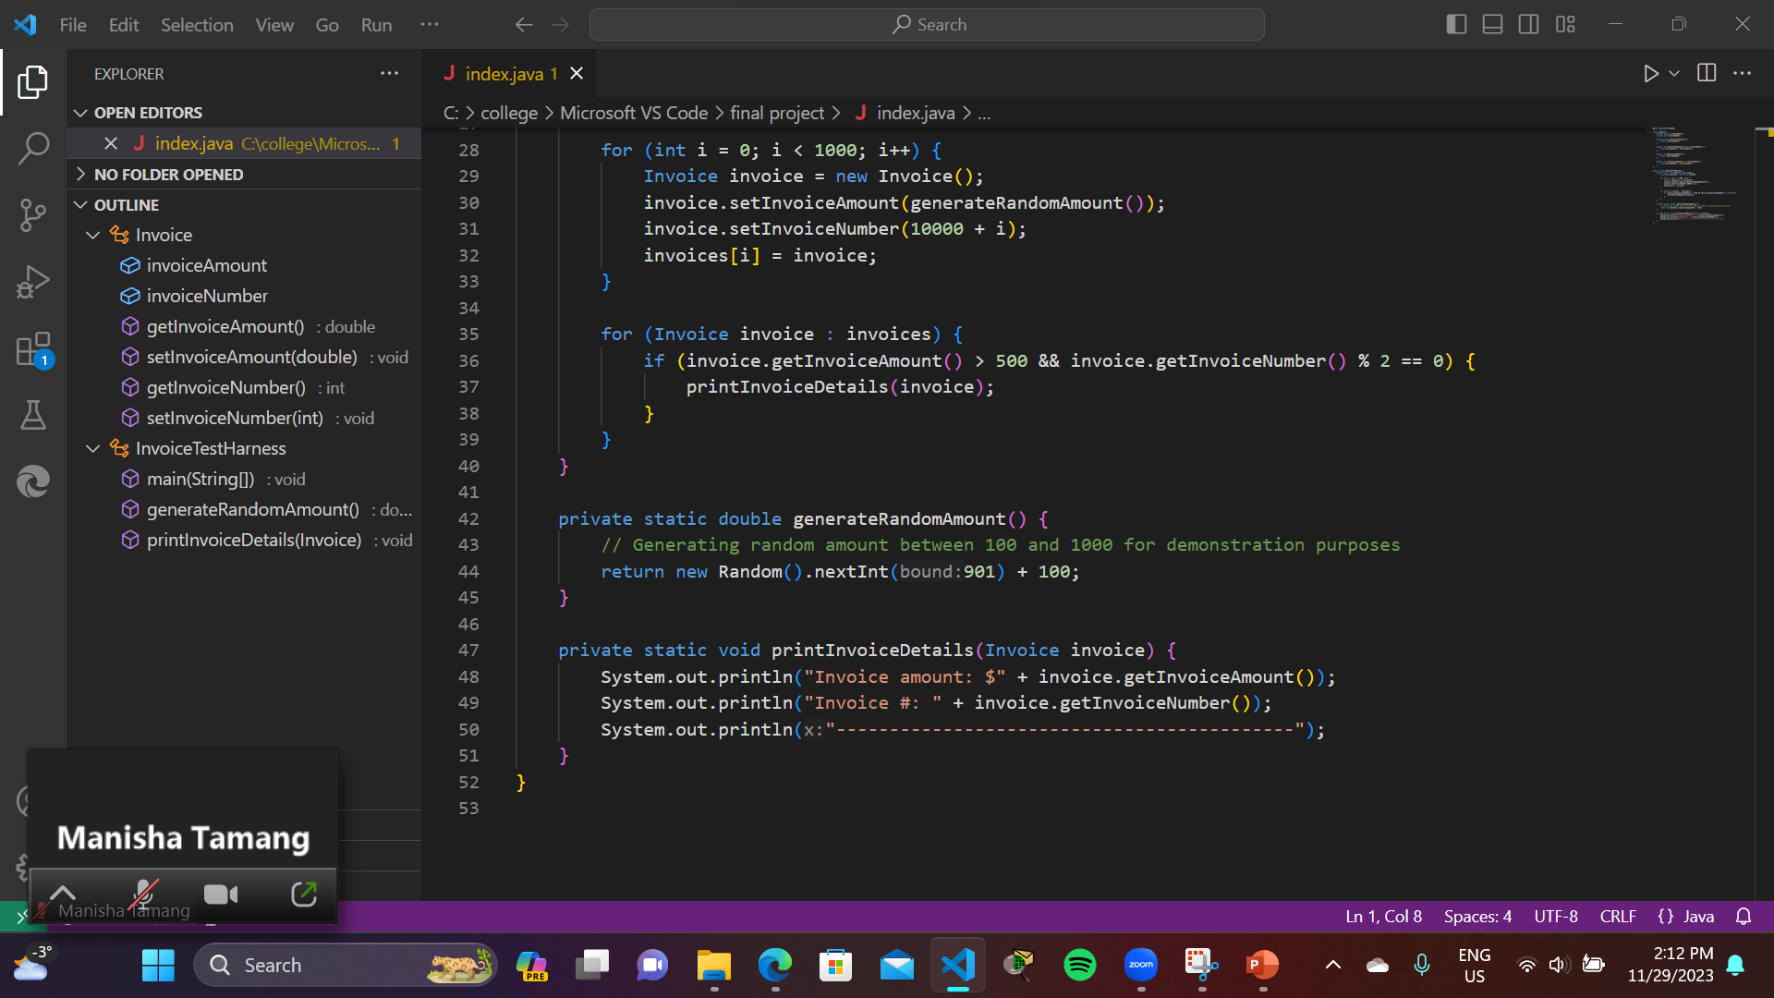

Slide 4
import java.util.Random;
class Invoice {
private double invoiceAmount;
private int invoiceNumber;
public double getInvoiceAmount() {
return invoiceAmount;
}
public void setInvoiceAmount(double invoiceAmount) {
this.invoiceAmount = invoiceAmount;
}
public int getInvoiceNumber() {
return invoiceNumber;
}
public void setInvoiceNumber(int invoiceNumber) {
this.invoiceNumber = invoiceNumber;
}
}
public class InvoiceTestHarness {
public static void main(String[] args) {
Invoice[] invoices = new Invoice[1000];
for (int i = 0; i < 1000; i++) {
Invoice invoice = new Invoice();
invoice.setInvoiceAmount(generateRandomAmount());
invoice.setInvoiceNumber(10000 + i);
invoices[i] = invoice;
}
for (Invoice invoice : invoices) {
if (invoice.getInvoiceAmount() > 500 && invoice.getInvoiceNumber() % 2 == 0) {
printInvoiceDetails(invoice);
}
}
}
private static double generateRandomAmount() {
// Generating random amount between 100 and 1000 for demonstration purposes
return new Random().nextInt(901) + 100;
}
private static void printInvoiceDetails(Invoice invoice) {
System.out.println("Invoice amount: $" + invoice.getInvoiceAmount());
System.out.println("Invoice #: " + invoice.getInvoiceNumber());
System.out.println("-------------------------------------------");
}
}

Slide 5
public class InvoiceTestHarness {
public static void main(String[] args) {
Invoice[] invoices = new Invoice[1000];
for (int i = 0; i < 1000; i++) {
Invoice invoice = new Invoice();
invoice.setInvoiceAmount(generateRandomAmount());
invoice.setInvoiceNumber(10000 + i);
invoices[i] = invoice;
}
for (Invoice invoice : invoices) {
if (invoice.getInvoiceAmount() > 500 && invoice.getInvoiceNumber() % 2 == 0) {
printInvoiceDetails(invoice);
}
}
}
private static double generateRandomAmount() {
// Generating random amount between 100 and 1000 for demonstration purposes
return new Random().nextInt(901) + 100;
}
private static void printInvoiceDetails(Invoice invoice) {
System.out.println("Invoice amount: $" + invoice.getInvoiceAmount());
System.out.println("Invoice #: " + invoice.getInvoiceNumber());
System.out.println("-------------------------------------------");
}
}

